Slide 1
Splice analysis of Risdiplam-treated
SMA patient derived iPSC-MN
TST11451
Dann Huh
11/20/2019

Slide 2
Acknowledgment
Splicing analysis and the pipeline
Jessica Hurt
Eric Marshall
Ellen Tsai
RNA-seq
Mei Liu
Chao Sun
Cells and project overall
Mercedes Beyna
Susanne Swalley

Slide 3
Sample Table (TST11451)
HiSeq
Mixed length: /IlluminaData/HiSeq/
190814_D00740_0171_ACDWHNANXX (75 X 67)
190816_D00740_0172_BCDWGYANXX (75 X 75)
Cells:
Cell line : GM24468D, HNDS006-01C2, HNDS0030-01 → iPSC-MN, D14.
Compound: RG7916 (Risdiplam)
Dose : 4, 40, 120, 400 nM (EC50 = 40nM for iPSCMN)
Time : 24 hour after the compound treatment
Replicates: Each treatment X4, DMSO control X 4
(except for HNDS0030-01 with 5 replicates of DMSO control)
Mapped to hg19 annotation without SMN1
GM24468D | HNDS006-01C2 | HNDS0030-01
RG7961-HCL 4 nM | RG7961-HCL 4 nM | RG7961-HCL 4 nM
RG7961-HCL 4 nM | RG7961-HCL 4 nM | RG7961-HCL 4 nM
RG7961-HCL 4 nM | RG7961-HCL 4 nM | RG7961-HCL 4 nM
RG7961-HCL 4 nM | RG7961-HCL 4 nM | RG7961-HCL 4 nM
RG7961-HCL 40 nM | RG7961-HCL 40 nM | RG7961-HCL 40 nM
RG7961-HCL 40 nM | RG7961-HCL 40 nM | RG7961-HCL 40 nM
RG7961-HCL 40 nM | RG7961-HCL 40 nM | RG7961-HCL 40 nM
RG7961-HCL 40 nM | RG7961-HCL 40 nM | RG7961-HCL 40 nM
RG7961-HCL 120 nM | RG7961-HCL 120 nM | RG7961-HCL 120 nM
RG7961-HCL 120 nM | RG7961-HCL 120 nM | RG7961-HCL 120 nM
RG7961-HCL 120 nM | RG7961-HCL 120 nM | RG7961-HCL 120 nM
RG7961-HCL 120 nM | RG7961-HCL 120 nM | RG7961-HCL 120 nM
RG7961-HCL 400 nM | RG7961-HCL 400 nM | RG7961-HCL 400 nM
RG7961-HCL 400 nM | RG7961-HCL 400 nM | RG7961-HCL 400 nM
RG7961-HCL 400 nM | RG7961-HCL 400 nM | RG7961-HCL 400 nM
RG7961-HCL 400 nM | RG7961-HCL 400 nM | RG7961-HCL 400 nM
DMSO vehicle | DMSO vehicle | DMSO vehicle
DMSO vehicle | DMSO vehicle | DMSO vehicle
DMSO vehicle | DMSO vehicle | DMSO vehicle
DMSO vehicle | DMSO vehicle | DMSO vehicle
 |  | DMSO vehicle
Monitor local splice difference for
each treatment vs DMSO control
Notes:
Bcl dir: /IlluminaData/HiSeq/181130_D00606_0195_ACCW0TANXX
Ref: hg19 without SMN1
gtf: /camhpc/dept/scicomp/public/splicing_work/gencode.v28lift37.noSMN1_fixed.gtf
fasta: /camhpc/dept/scicomp/public/splicing_work/hg19as_SMN1_masked.fa
BIO-1790727 is what the BioAssays and HTS group use as a positive control (lower tox than LMI070)
LMI070, BIO-1755497, Branaplam, NVS-SM1
SMN-C2 is BIO-1932671
RG7916, Risdiplam, free base version of the compound is BIO-1949634
RG7916 more soluble HCl salt is BIO-1949634
SMN-C3 – I do not know. (However, we have an analog (missing a methyl group) of SMN-C3 called BIO-1932673.)
Siva would be able to give you the BIO #s that I don’t have.
Best,

Slide 4
Estimate EC50 in 96-well format (iPS-MN DIV12); RG7916
GM24468D
HNDS006-01C2
average = 36.5 nM
HNDS0030-01
EC50 (nM) = 88
EC50 (nM) = 43
EC50 (nM) = 30
EC50 (nM) = 8
EC50 (nM) =
EC50 (nM) = 5
Mercedes Beyna

Slide 5
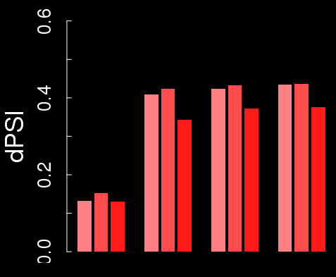
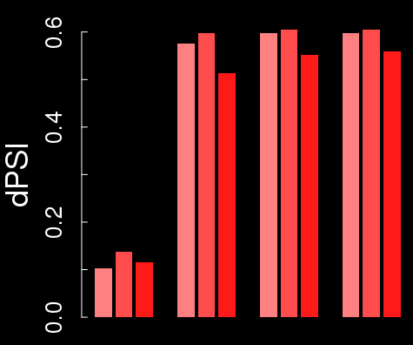
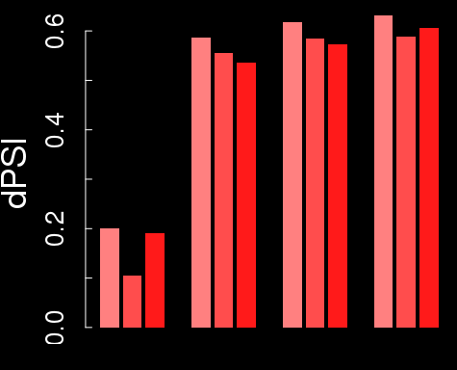
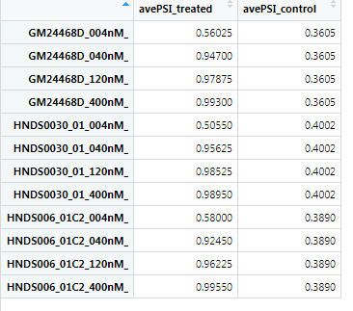
Delta-PSI of SMN2 exon7 is around 60%,
due to 40% PSI in SMA iPSC-MN
rMATS
Leafcutter
Majiq
GM24468D
HNDS006-01C2
HNDS0030-01
FDR
0.02
0.33
0.001
FDR
0.59
0.37
0.59
004 040 120 400nM
004 040 120 400nM
004 040 120 400nM
dPSI ~ 60%, which is higher than ~50% seen in fibroblast.
➔ (1) baseline PSI in untreated SMA iPSC-MN is ~40%, different from fibroblast.
(2) Risdiplam bring PSI close to 100%, as in fibroblast.
Notes:
Junc_coords: hg19, chr5:69366578-69372846

Slide 6
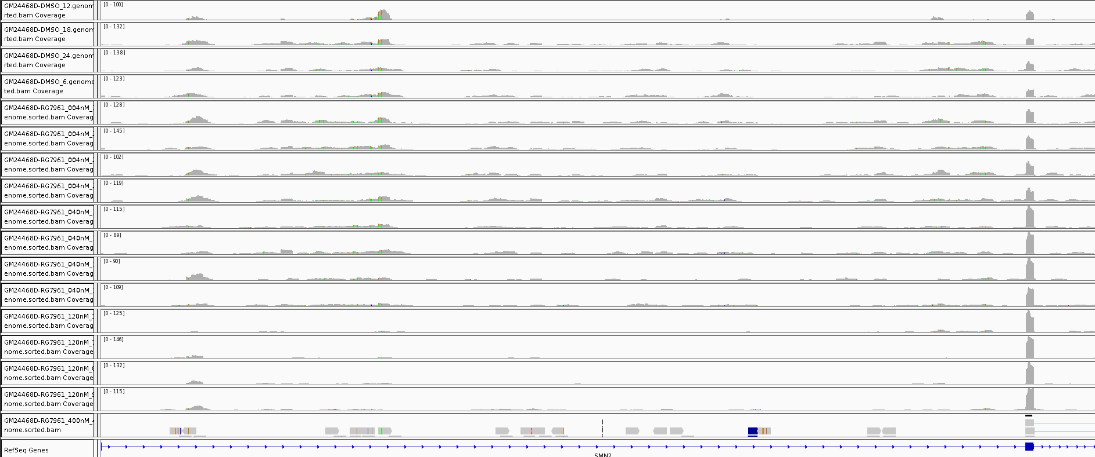
Trace of SMN2 exon7 after Risdiplam treatment
GM24468D
DMSO
DMSO
004nM
004nM
040nM
040nM
120nM
120nM
➔ Reduction of intronic transcripts are also seen as in the fibroblast data (what about GSE108094?)

Slide 7
Parameters for thresholding : similar to fibroblast data
(supplementary slide)
rMATS: FDR<0.05, dPSI> 0.30
Leafcutter: FDR<0.05, dPSI > 0.20
Majiq: P(dPSI) > 0.90, E(dPSI)>0.30

Slide 8
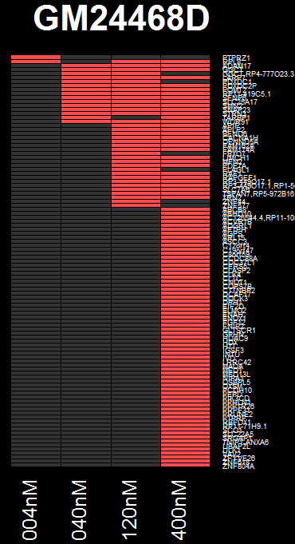
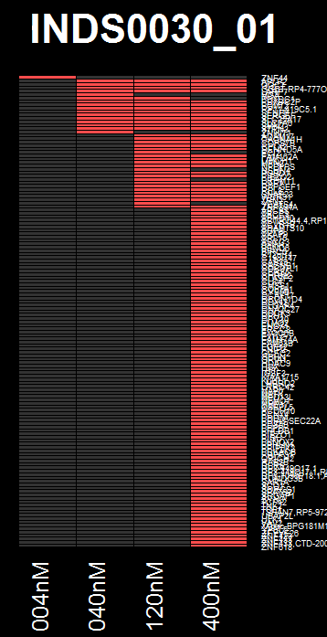
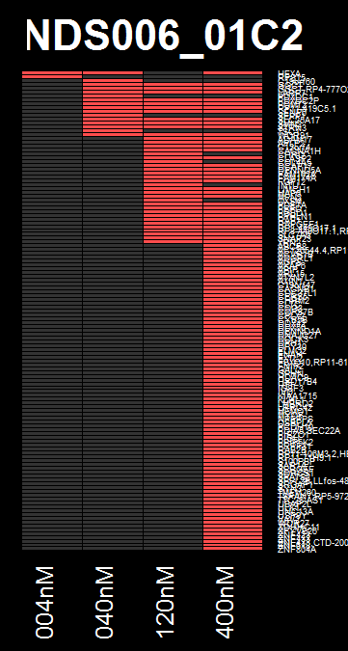
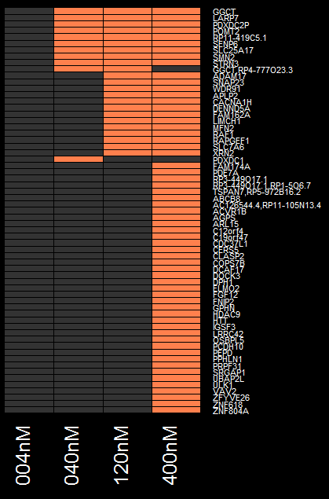
Common DSG across different cell lines
TOTAL OFF-TARGET PER CELLLINE, and VENN-D
GGCT
LARP7
PDXDC2P
POMT2
RP11-419C5.1
SENP6
SLC25A17
SMN2
STRN3
Common genes
ADAM17
SNAP23
WDR91
APLP2
CACNA1H
DENND5A
FAM162A
LIMCH1
MFN2
RAF1
RAPGEF1
SLC7A6
XRN2
rMATS: FDR<0.05, dPSI> 0.30
Leafcutter: FDR<0.05, dPSI > 0.20
Majiq: P(dPSI) > 0.90, E(dPSI)>0.30
➔ UNION of genes
0, 11, 23, 61 genes
Notes:
C:\Users\dhuh\Desktop\Project\SMA\TST11451_SMASM_iPSCMN\analysis\analysis_02_combined_DSG\res.02.compare_plot_DSG_abThr\DSG_per_cellline_per_dose
C:\Users\dhuh\Desktop\Project\SMA\TST11451_SMASM_iPSCMN\analysis\analysis_02_combined_DSG\res.02.compare_plot_DSG_abThr\DSGoverlap_genes_per_dose.txt
TEX21P: minFDR=0.51, Not significant anywhere
Average expression:
iPSCMN : 1.77
fibroblast: 1.85
iPSCMNSMA: 0.26

Slide 9
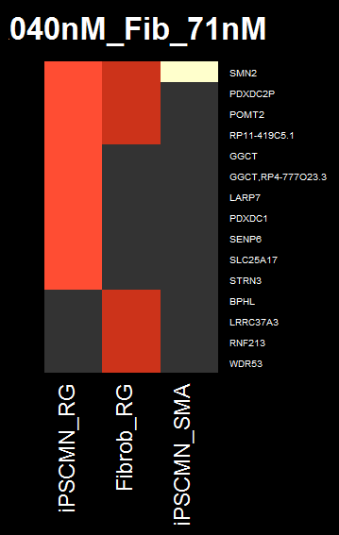
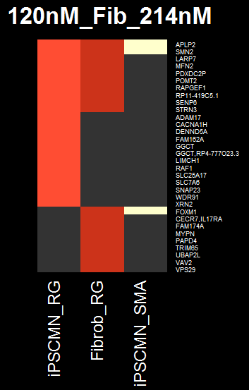
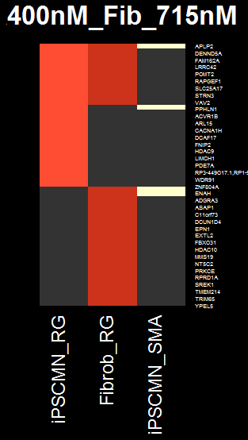
Comparison of iPSC-MN(common)+RG, Fibroblast+RG, 4 SMA vs 4 ctrl (GSE108094) : only a few genes overlap
iPSCMN 40nM, Fib 71nM
iPSCMN 120nM, Fib 214nM
iPSCMN 400nM, Fib 715nM
APLP2
SMN2
SMN2
APLP2
SMN2
CERS5
PPHLN1
FOXM1
CFAP70
CTNS
ENAH
FOXM1
➔ There are ~30% overlap between fibroblast and iPSC-MN
➔ Off-targets of risdiplam is probably NOT due to SMN normalization
Notes:
grep FOXM1 res_comb_*nM_*/master_rMATS.txt | awk -F'\t' '{print $6}' | sort -u
minFDR for FOXM1: 0.08

Slide 10
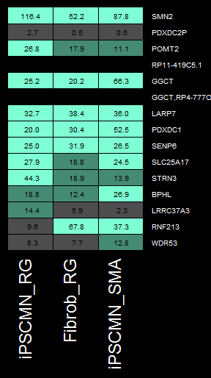
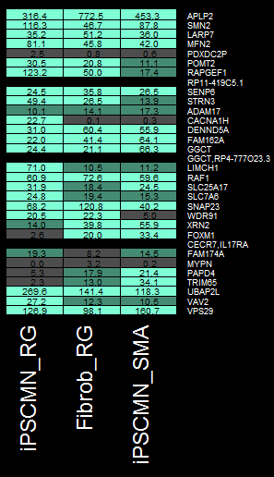
The discrepancy is not fully explained by expression level difference
iPSCMN 40nM, Fib 71nM
TPM
iPSCMN 120nM, Fib 214nM
TPM
Notes:
grep FOXM1 res_comb_*nM_*/master_rMATS.txt | awk -F'\t' '{print $6}' | sort -u

Slide 11
FOXM1

Slide 12
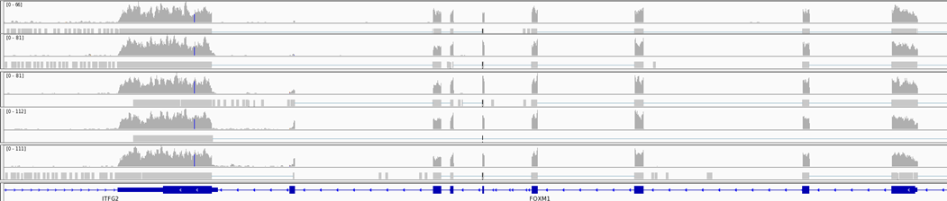
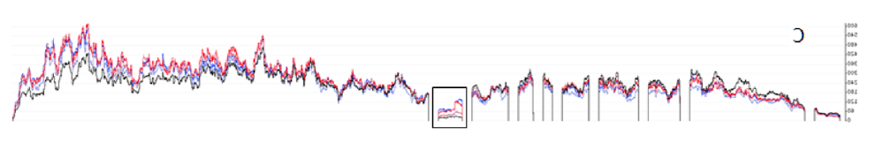
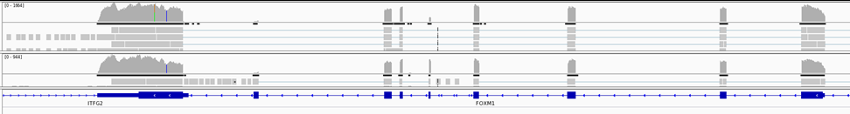
Differential splicing of FOXM1 in fibroblast+risdiplam is a different event from SMA iPSC-MN
Fibroblast+risdiplam (TST11354)
DMSO
01x
03x
10x
30x
Ratni et al
(flipped)
iPSC-MN from SMA vs control (GSE108094)
control
SMA
➔ FOXM1 differential splicing in Fib+Risdiplam is likely due to the compound,
not due to normalization of SMN protein level

Slide 13
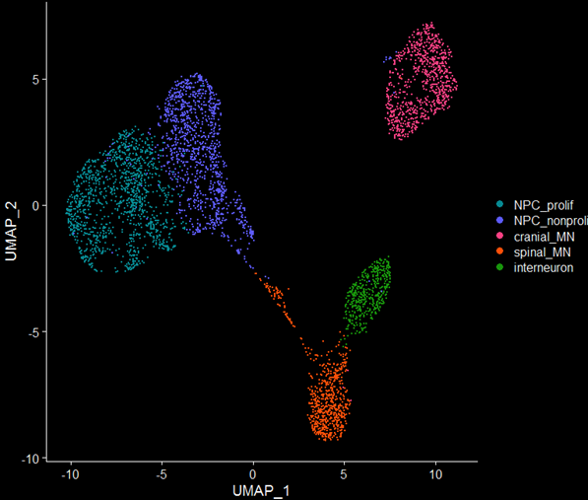
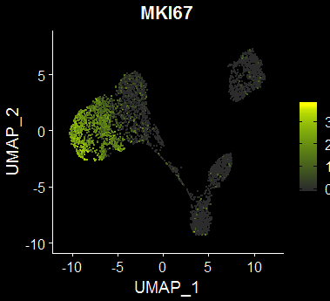
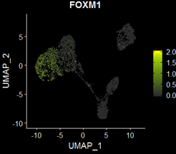
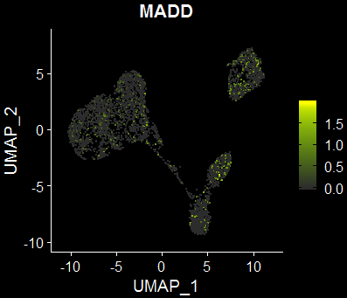
In iPSC-MN, FOXM1 is mostly expressed in proliferating progenitor cells
FOXM1 splicing was not detected in iPSC-MN+risdiplam, unlike fibroblast+risdiplam.
FOXM1 expression was low in iPSC-MN(+risdiplam) , which explains this discrepancy.
➔ This difference can be attributed to the fraction of proliferating cells in fibroblast vs iPSC-MN
previous single-cell RNA-seq data of iPSC-MN (with Shila) shows that FOXM1 is expressed almost
exclusively in proliferating progenitors, but not in post-mitotic cells.
➔ To fully account for the discrepancy, cell-type composition in current bulk RNA-seq (TST11451) should be estimated (not done).
Notes:
C:\Users\dhuh\Desktop\Project\SMA\TST11451_SMASM_iPSCMN\analysis_compare_scRNA_seq
C:\Users\dhuh\Desktop\Project\SMA\TST11451_SMASM_iPSCMN\analysis_compare_scRNA_seq\01.iPSCMNre_goi_plot

Slide 14
DEG

Slide 15
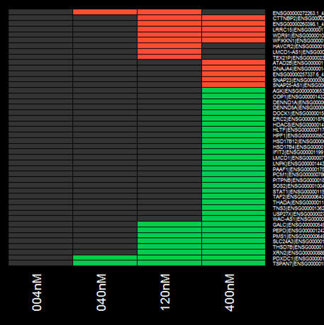
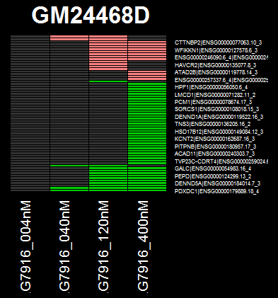
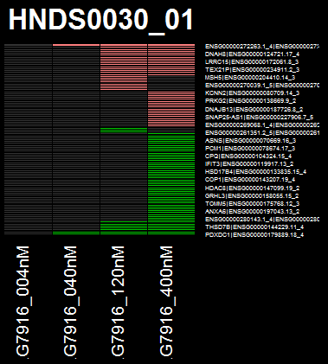
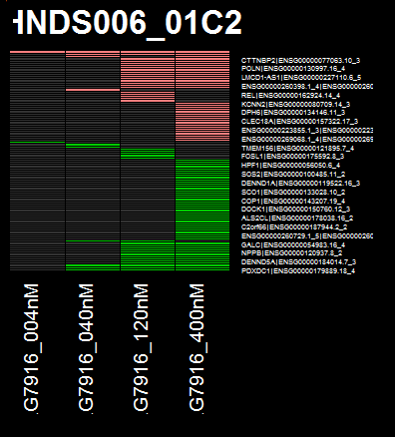

Common DEG across different cell lines
Common_genes
CTTNBP2
ENSG00000260398
LRRC15
WDR91
WFIKKN1
FDR<0.05, |log2(FC)| > 1
GALC
PEPD
PMS1
SLC24A3
THSD7B
XRN2
PDXDC1
TSPAN7
TEX21P up-regulated (>2x) in 120nM+ dosing,
Except for GM24468D cell line
(p.adj=NA due to low counts, but p.val<1e-7)
0 3 17 42 genes
004 040 120 400nM
Up and Down
in RG7916 group
GM24468D
HNDS0030_01
HNDS005_01C2
Notes:
C:\Users\dhuh\Desktop\Project\SMA\TST11451_SMASM_iPSCMN\analysis_DEG\03.DEG_anal\thr_LFC_1.0_FDR_0.05
C:\Users\dhuh\Desktop\Project\SMA\TST11451_SMASM_iPSCMN\analysis_DEG\03.DEG_anal\common_DEG

Slide 16
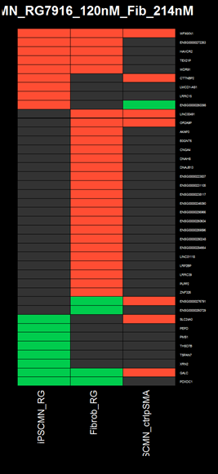
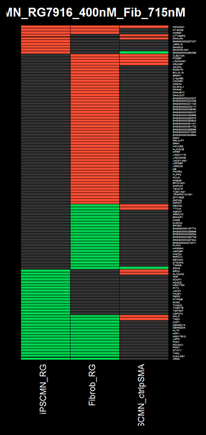
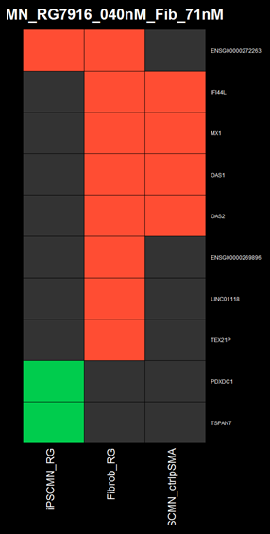
DEG comparison: ~15% overlap between fibroblast and iPSC-MN
WFIKKN1 ENSG00000272263
HAVCR2
TEX21P
WDR91
WFIKKN1
ATAD2B
WDR91
GALC
TNS3
COP1
DENND1A
DENND5A
HLTF
HPF1
HSD17B12
LNPK
PCM1
PDXDC1
PMS1
STAT1
TAF2
WAC-AS1
XRN2
GALC
PDXDC1
Common across 3 iPSC-MN cell lines
FDR<0.05, |log2(FC)| > 1
Notes:
C:\Users\dhuh\Desktop\Project\SMA\TST11451_SMASM_iPSCMN\analysis_DEG\04.DEG_anal_overlapping_genes_fib_MN

Slide 17
Motif

Slide 18
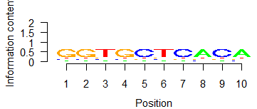
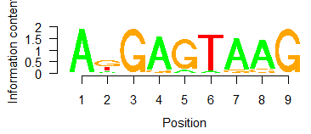
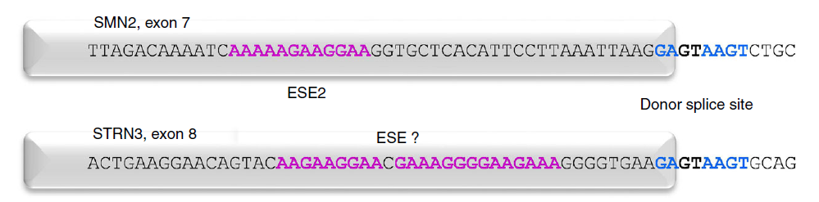
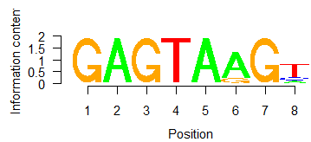
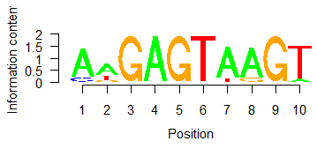
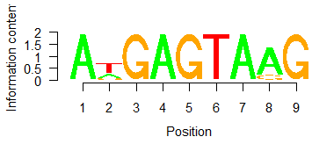
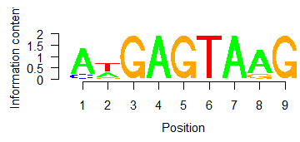
Near 5’SS, AnGAGTAAG is found as enriched motif
iPSC-MN + Risdiplam, “Spliced Exon” from rMATS only, ±5bp from the end of the exon
Homer, background matched by ±5bp from random exons
HNDS0006_01, dPSI>0.3
HNDS0006_01, dPSI>0.1
comparison: Sivaramakrishnan, 2017
40nM
120nM
(“AAAAAGAAAGAAA” under investigation)
400nM
(The other cell lines showed very similar results)
(±100bp also showed very similar result)
Notes:
C:\Users\dhuh\Desktop\Project\SMA\TST11451_SMASM_iPSCMN\analysis_motif

Slide 19
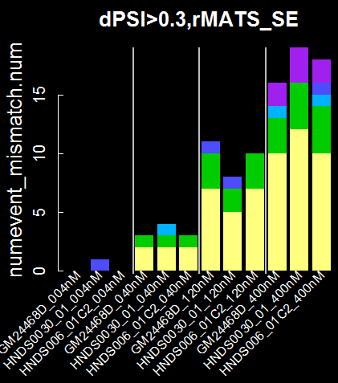
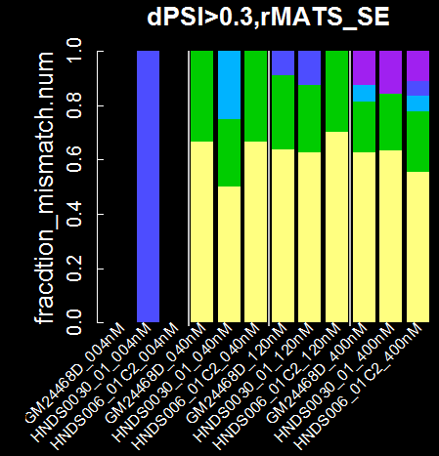
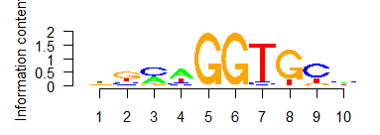
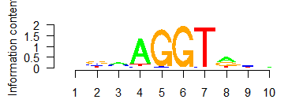
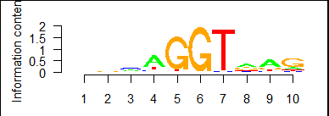
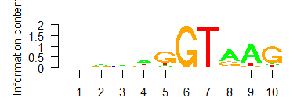
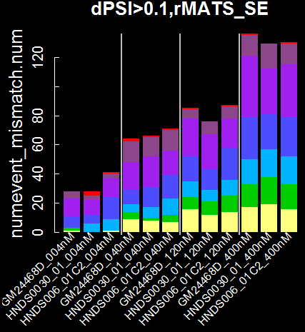
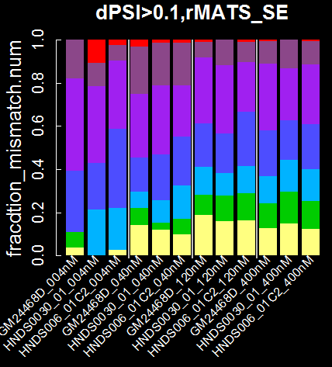
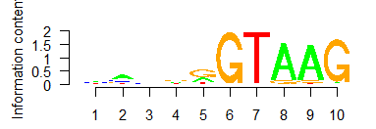
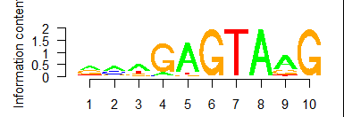
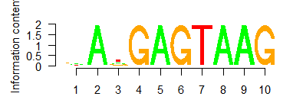
Off-targets can have mismatched motifs, across all doses of risdiplam in iPSC-MN
-5-4-3-2-1 1 2 3 4 5
Position
1~2 : always GT
-1 : A→G, canonical 5’ss?
3~5 : AAG fades
-3: A→N from 1 mismatch on.
6
5
4
num. mismatch
From AnGAGTAAG
3
2
1
0
-5-4-3-2-1 1 2 3 4 5
HTT: CAGAGTAAGGGGG
speculation:
1. 0.1 vs 0.3: Low dPSI threshold allows more fraction of mismatched motifs
=> mismatched motifs have lower probability of getting spliced.
2. Across dose: Fraction of num.mismatch do not change much as a fnc
of increasing dose => off-target motifs are expected to have similar EC50
>
dPSI
dPSI
dose
dose

Slide 20
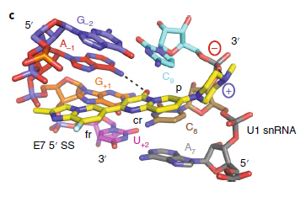
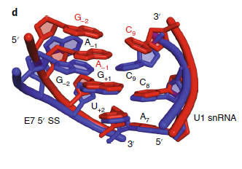
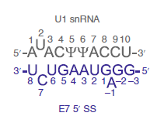
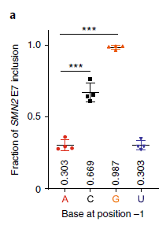



A-1G becomes an off-target only when canonical AAG is not in place
SMN-C5
Probably GGTnnn became a weak binding site as it lost AAG to nnn, and splicing on this weak site can be enhanced by risdiplam. If the sequence were GGTAAG, it would have been spliced well to begin with, just like Campagne paper. (Sue Swalley)
-5-4-3-2-1 1 2 3 4 5
6
5
4
num. mismatch
From AnGAGTAAG
3
2
1
0
Risdiplam
-5-4-3-2-1 1 2 3 4 5
➔ splicing of off-targets with mismatches might have different structure with compound-bound form
Campagne 2019

Slide 21




In fibroblast data, it is hard to explain the fraction of off-targets with mismatches
90727: nnGAGTAnG
LMI070: nAGAGTAnG
RG7916: AnGAGTAAG
(Next slide)
6
5
4
num. mismatch
From motif/compound
3
cell-line difference?
high-dose is problem?
2
1
0
???

Slide 22



















90702, LMI070, and RG7916 share GAGTAAG motif
-5-4-3-2-1 1 2 3 4 5
-5-4-3-2-1 1 2 3 4 5
90702: nnGAGTAnG
LMI070: nAGAGTAnG
RG7916: AnGAGTAAG
1. Similar progression across all three compounds:
1~2: GT
-1: A->G
3~5: AAG fades
2. Differences:
-2: 90727 and LMI070 have
stronger G-> A
-3: A in LMI070
-4: A in RG7916
-5-4-3-2-1 1 2 3 4 5
6
5
4
num. mismatch
From motif/compound
3
2
1
0
-5-4-3-2-1 1 2 3 4 5
-5-4-3-2-1 1 2 3 4 5
-5-4-3-2-1 1 2 3 4 5
-5-4-3-2-1 1 2 3 4 5
90727
LMI070
RG7916
RG7916, iPSC-MN
Notes:
Alldose, per compound

Slide 23
Summary
20~60 splicing off-targets of Risdiplman in iPSC-MN
Splicing off-targets of Risdiplam between fibroblast and iPSC-MN is about 50%.
Number of splicing off-targets of Risdiplam is similar between fibroblast and iPSC-MN
17~42 differentially expressed genes (DEG) after Risdiplam treatment in iPSC-MN
DEG between fibroblast and iPSC-MN have ~15% overlap
This is partially explained by gene expression itself.
FOXM1 is only detected in proliferating population, where it can be toxic.
Most of the off-targets share common motif with SMN2.
Off-targets that do not share the motif presumably have weaker splicing motif,
deviating from canonical sequence.
Notes:
Alldose, per compound

Slide 24

Adandum 20210519: FOXM1 exon9 has the risdiplam motif
SMA fibroblast
Exon9 of FOXM1
90702: nnGA|GTAnG
LMI070: nAGA|GTAnG
RG7916: AnGA|GTAAG
09727 10X
Revcomp:
90702: CnTAC|TCnn
LMI070: CnTAC|TCTn
RG7916: CTTAC|TCnT
DMSO
Exon9 3’:
CTTAC|TGAT
Brana
➔ One mismatch
Exon9 middle:
CTTAC|TCAT
Risd
➔ Perfect match
Notes:
Alldose, per compound

Slide 29



PCA from TPM – PC2~cell line. PC1?? (not dose)
20190913095214

Slide 30


20190913095229: the same

Slide 31







PCA from TPM, per cell line ➔ none sense

Slide 32

Euclidian distance, hierarchical clustering on vst

Slide 33
Prev

Slide 34

Three different algorithms are used for splice analysis
Focusing on local splicing event rather than full quantification of splice isoforms
C₁+C₃
C₁+2*C₂+C₃
C₁
C₃
Measure1: Percent Spliced In : e.g., exon skipping:
Ψ=
C₂
Measure2: dPSI = ΔΨ = Ψ_{treatment} - Ψ_{control}
Input: read counts from RNA-seq
Most straightforward interpretation;
low-counts are not handled well
Different definition of “PSI”;
Intron centric
Different definition of “PSI”;
Junction centric;
Bayesian interpretation (no p.val)
Output: PSI and dPSI with statistical significance
All three algorithm use
different statistical models
Eric Marshall, Ellen Tsai, Jessica Hurt

Slide 35
The difference in SMN2 dPSI between algorithms comes from varying definitions of “PSI”
rMATS : does not even use the word PSI, just called “Inclusion Level Difference”
Leafcutter: “Percent Spliced In”
Majiq: “Percent Selected Index” (one junction at a time)
<DMSO>
<RG7916>
C₁=16
C₃=29
C₁=54
C₃=79
Example:
Delta
C₂=20
C₂=0
rMATS
C₁+C₃
C₁+2*C₂+C₃
0.53
1.0
0.47
Leafcutter
C₁+C₃
C₁+C₂+C₃
0.69
1.0
0.31
Majiq
C₁ C₃
C₁+C₂ C₂+C₃
or
0.44 or 0.59
1 or 1
0.56 or 0.41

Slide 36
Splicing:
Setting cutoffs for dPSI

Slide 37
Criteria for dPSI and related parameters
(1) Minimal set of splice isoforms that explain biological signature
➔ no phenotype available.
(2) Data-driven:
a. upper bound: SMN2 must be included
b. lower bound: null-comparison should give (close to) no positive signal
c. consistency: junctions significant in lower dose should
also be significant at higher dose, with consistent direction
➔ These will depend on effect size, within- and between- sample variability, read depth, and sample size.
➔ Parameter set for this experiment is not transferrable to other experiment.

Slide 38
Optimal parameters set by consistency measure
(2) Data-driven
a. upper bound: SMN2 must be included
b. lower bound: null-comparison should give no positive signal
c. consistency: junctions significant in lower dose should
also be significant at higher dose, with consistent direction
accepted pattern (all)
dPSI
(junction level)
dose
dose
dose
dose
dose
, and their reflection on x-axis
rejected pattern (partial)
dPSI
(junction level)
...
dose
dose
dose
dose
dose
, and their reflection on x-axis

Slide 39



Compound Alias
Current experiment
BIO-1790727
Sivaramakrishnan
LMI070, Branaplam, NVS-SM1, BIO-1755497
“Compound 10”
SMN-C3
Ratni
RG7916, Risdiplam,
BIO-1949634
“Compound 2”
RG7800
Notes:
BIO-1790727 is what the BioAssays and HTS group use as a positive control (lower tox than LMI070)
LMI070, BIO-1755497, Branaplam, NVS-SM1
SMN-C2 is BIO-1932671
RG7916, Risdiplam, free base version of the compound is BIO-1949634
RG7916 more soluble HCl salt is BIO-1949634
SMN-C3 – I do not know. (However, we have an analog (missing a methyl group) of SMN-C3 called BIO-1932673.)
Siva would be able to give you the BIO #s that I don’t have.

Slide 40
Differential Expression:
Comparison with patient-derived iPSC-derived motor neurons

Slide 41



Due to the cell-line effect, PC1 is regressed from the RNA-seq data of iPSC-derived motor neurons
Question: How many of the DEG from our current experiment are off-target effect?
≈ Can compound treatments reverse gene-expression signature?
➔ RNA-seq data from iPSC-derived motor neuron, patient line vs control line [Rizzo F, Brain, 2019. GSE108094]
Fastq are downloaded and re-processed
No PC1 reg
RNA-seq design:
Ctrl MN1 replicate 1
Ctrl MN1 replicate 2
Ctrl MN2 replicate 1
Ctrl MN2 replicate 2
SMN MN1 replicate 1
SMN MN1 replicate 2
SMN MN2 replicate 1
SMN MN2 replicate 2
w/ PC1 reg
Notes:
PC1: regress out.
-43.486253 -47.250285 -6.810535 -5.822279 -83.487053 -87.860717 138.379831 136.337290
PC2: disease-control
-2.776975 5.385721 -99.801455 -108.816170 60.273263 71.769431 36.160256 37.805929

Slide 43
Packages and Algorithms

Slide 44

Leafcutter: intron centric, PSI per cluster, novel jnc
input: .bam (.gtf comes later)
output: intron cluster significance, PSI and dPSI per cluster, logFC, intron coord,
but NO p.val for PSI/dPSI

Slide 45












Leafcutter: Dirichlet-multinomial generalized linear model
i.e., multinomial with dispersion
“x_{i}” is not explained in the paper

Slide 46




rMATS: Exon centric, UTR considered, no novel jnc
input: .bam and reference
output: type specific (e.g., SE, A5SS) PSI, dPSI, foldchange, pval, FDR, exon coord.

Slide 47



MAJIQ: Junction centric, novel jnc
different “PSI”: “Percent Selected Index”, ➔ I’ll call LPSI
not “percent splice included”
LSV: “Local Junction Variant” – does not directly report exon inclusion/exclusion
A5SS, A3SS included.
input: .bam and reference
output: LSV coord, LPSI and dLSPI, Prob(|dLPSI| > thr_p)

Slide 48

MAJIQ: Junction centric, novel jnc

Slide 49






MAJIQ: Junction centric, novel jnc
J = number of junctions
input: .bam and reference
output: LSV coord, LPSI and dLSPI, Prob(|dLPSI| > thr_p)

Slide 51

dPSI threshold – leafcutter, RG7916 and cell-line difference

Slide 52



Example: rMATS , thr_dSPI = 0.30, thr_maxjnc=50, null-comparison
Showing FDR<0.05
(not p.val)
Thr_dPSI=0.25 still leaves 5~10 false discovery (in leafcutter, these are zero)

Slide 53







Example: rMATS , thr_dSPI = 0.30, thr_maxjnc=50
Genes with junctions passed consistency filter
unwanted
Ideally
Zero
Genes with junctions passed FDR<0.05 & dPSI < xx
& <max.jnc> > 50 at the highest conc.
At thr_dSPI=0.30 and thr_maxjnc=50, there are 1, 1, and 0 inconsistent genes for GM, HNDS006, and HNDS003
➔ thr_dPSI=0.20 can do the same, but this is below the lower bound

Slide 54

dPSI threshold – leafcutter, randomized – all zero.

Slide 55

leafcutter , thr_dSPI = 0.20
unwanted
Genes with junctions passed consistency filter
Ideally
Zero
Genes with junctions passed FDR<0.05 & dPSI < xx
At thr_dSPI=0.20, there are 0, 0, and 1 inconsistent genes for GM, HNDS006, and HNDS003
➔ thr_dPSI=0.20 can do the same, but this is below the lower bound

Slide 56



About 75% of DSG exclusively called in leafcutter, are non-annotated
Check annotation vs cryptic using leafcutter result, and count genes.
In Leafcutter, not in rMATS or Majiq:
DSG in leafcutter, all.
This might be true for any leafcutter DSG in general
➔ no, overlap with rMATs must be annotated.
Haven’t checked the overlap numbers and thresholds.

Slide 57




Common DSG across different cell lines
004nM
040nM
120nM
400nM

Slide 58


GSE108094, 4 SMA vs 4 ctrl, and null set
Showing FDR<0.05 (not p.val)
rMATS: thr_maxjnc=50, thr_dPSI=0.25
Leafcutter: thr_dPSI=0.20
as in iPSCMN
no other guidance.
mj: EdPSI=0.3 and PdPSI> 0.9.
(SMN2 is excluded, (PdPSI~0.4), but the next option is EdPSI>0.2, which is not ideal.
Null set A seems to be probalmatic.

Slide 59



Overlap btw iPSC-MN(common)+RG, Fibroblast+RG
(120,214)
(400,715)
(40,71)nM

Slide 60


Differentially expressed genes

Slide 61




Per cell line, 1.5x change
Common_genes
Up and Down
in RG7916 group
FDR<0.05, |log2(FC)| > 0.58 (1.5x)
Notes:
C:\Users\dhuh\Desktop\Project\SMA\TST11451_SMASM_iPSCMN\analysis_DEG\03.DEG_anal\thr_LFC_1.0_FDR_0.05

Slide 62




Fibroblast, RG7916, 10x, leafcutter
(30x also shows same region spliced)
GSE108094, leafcutter
Expression in dividing vs post-mitotic cells? scRNA-seq data?

Slide 63

Fibroblast, RG7916
Showing
chr12:2,967,517-2,972,174
Ratni, flipped

Slide 64

Fibroblast, RG7916
Ratni, flipped

Slide 65

GSE108094
Showing
chr12:2,967,517-2,972,174

Slide 66

GSE108094
chr12:2973918-2975559

Slide 67

GSE108094
chr12:2973918-2975559

Slide 68

iPSC-MN, RG7916, GM24468, FOXM1 : too few reads

Slide 69

iPS-MN samples prepared for RNA-seq (for internal benchmarking of Risdiplam)
Mercedes Beyna
July 29, 2019
SMA SM Phenotypic Screen

Slide 70
Executive Summary (slide taken from DPAC memo Sue Swalley)
Program Goal | Through a phenotypic screening approach, we aim to develop an orally available small molecule that raises SMN protein levels - either alone or in combination with other small molecules or modalities - to levels equal to or greater than those obtained by current splice modulators, and with fewer potential safety liabilities.
Molecular Hypothesis | SMA is caused by the mutation or deletion of the SMN1 gene and reliance on the SMN2 gene, a paralog gene that produces reduced levels of full-length protein due to inefficient splicing. An efficacious small molecule that increases levels of SMN protein is likely to be therapeutic.
Therapeutic Rationale | Biogen's portfolio for SMA includes Spinraza, an anti-sense oligonucleotide (ASO) that modulates SMN2 pre-mRNA splicing, and BIIB089, a gene therapy approach for overexpressing SMN1. Both approaches have minimal peripheral impact. The lack of an oral small molecule that can increase SMN protein levels, either by splice modulation or alternative mechanisms, is a critical gap. Our phenotypic screen is not limited to splice modulation and potentially captures both U1snRNP-stabilizing splice modulators (MoA of risdiplam and branaplam) as well as novel molecular mechanisms.
Portfolio Fit | SMA Small Molecule

Slide 71
Benchmarking (slide taken from DPAC memo Sue Swalley)
We will perform in-depth, in-house benchmarking in order to fully understand potential areas of differentiation.
Transcriptomic analysis, protein quantitation and gene splicing ratios
Patient fibroblasts
(literature RNAseq data)
iPSC-MNs
(no literature RNAseq data)
Brain, spinal cord & muscle tissues
-Hung SMA mouse model
-Δ7 mouse model
Efficacy testing using the Δ7 mouse model
Survival
Weight gain
Righting reflex
In vitro safety evaluation
Splicing of FOXM1 and MADD genes (on-mechanism for splice modulators)
Melanin binding, although the connection to NHP retinal toxicity is only a hypothesis
Phototoxicity, micronuclei, hERG, phospholipidosis

Slide 72

Published EC50 data, RG7916 (slide from DPAC memo Sue Swalley)
FL EC50 (nM) = 29
Δ7 EC50 (nM) = 12
EC50 (nM) = 12
EC50 (nM) = 182
Ratni et al, J. Med. Chem. 61, 6501-6517 (2018).

Slide 73
SMA patient fibroblast GM03813 with RG7916 (my historical data)
mRNA (24-hour)
Protein (48-hour)
EC50 (nM) = 64.2
EC50 (nM) = 12.8
EC50 (nM) = 47.8
EC50 (nM) = 180
EC50 (nM) = 38.5
EC50 (nM) = 95.1

Slide 74
Determine EC50 in SMA patient iPS-MN; mRNA (24-hour), RG7916
GM24468D
HNDS006-01C2
HNDS0030-01

Slide 75
Estimate EC50 in 96-well format (iPS-MN DIV12); RG7916
GM24468D
HNDS006-01C2
average = 36.5 nM
HNDS0030-01
EC50 (nM) = 88
EC50 (nM) = 43
EC50 (nM) = 30
EC50 (nM) = 8
EC50 (nM) =
EC50 (nM) = 5

Slide 76
Treatment conc in 6-well format (iPS-MN DIV14); RG7916
61 samples in total were generated for RNA-seq:
3 independent lines of SMN patient iPS-MN
4 treatment conditions in general but 1 extra DMSO was collected for 1 line

Slide 77
Sample Key for RNA-Seq; qPCR done on highlighted samples

Slide 78

Treatment conc in 6-well format (iPS-MN DIV14); RG7916

Slide 79
As expected, SMN2 Δ7 transcript decreased with RG7916 Tx
6-well data (each data point is a qPCR technical replicate)
96-well data (each point is a well)

Slide 80
As expected, SMN2 FL transcript increased with RG7916 Tx
6-well data (each data point is a qPCR technical replicate)
96-well data (each point is a well)

Slide 81
As expected, SMN2 FL transcript increased with RG7916 Tx
6-well data (each data point is a qPCR technical replicate)
Concentration dependent effect is captured.
Exactly 2-fold change at EC50 range of 40nM
Plateau of effect observed (120 and 400 nM)
Biological replicate data acceptable
96-well data (each point is a well)

Slide 82
TEX21P increased in a conc-dependent manner with RG7916 Tx
TEX21P in a non-coding RNA that Dann showed is alternatively spliced in the fibroblast RNA-seq
Please forgive the typo– correct transcript name is “TEX21P”

Slide 83
I recommend progressing with the samples
Concentration dependent effect is captured. For example, for SMN2 full-length:
Exactly 2-fold change at EC50 range of 40nM.
Plateau of effect observed (120 and 400 nM).
Biological replicate data of acceptable variability.
qPCR was performed only on 10 samples although 61 samples were submitted
(a single line with a half of its samples).

Slide 84
FOXM1

Slide 85


Differential splicing of FOXM1 in fibroblast+risdiplam is different event from SMA iPSC-MN
Fibroblast+risdiplam (TST11354),
10x, (30x show similar result)
iPSC-MN + risdiplam (TST11451)
SMA vs control iPSC-MN (GSE108094)
➔ No differential splicing

Slide 86
Con’d
Fibroblast+risdiplam (TST11354)
Ratni et al, flipped

Slide 87
Con’d
iPSC-MN from SMA vs control (GSE108094)

Slide 88
In iPSC-MN, FOXM1 is mostly expressed in proliferating progenitor cells
FOXM1 splicing was not detected in iPSC-MN+risdiplam, unlike fibroblast+risdiplam.
FOXM1 expression was low in iPSC-MN(+risdiplam) , which explains this discrepancy.
➔ previous single-cell RNA-seq data of iPSC-MN (with Shila) shows that FOXM1 is expressed almost
exclusively in proliferating progenitors, but not in post-mitotic cells.
➔ To fully account for the discrepancy, cell-type composition in current bulk RNA-seq (TST11451) should be estimated (not done yet).
Notes:
C:\Users\dhuh\Desktop\Project\SMA\TST11451_SMASM_iPSCMN\analysis_compare_scRNA_seq
C:\Users\dhuh\Desktop\Project\SMA\TST11451_SMASM_iPSCMN\analysis_compare_scRNA_seq\01.iPSCMNre_goi_plot

Slide 89



For other genes, cell-type specific expression do not necessarily explain the discrepancy
Avarage nomarlized UMI count per cell type from scRNA-seq of iPSC-MN
z-score of <nUMI> per gene
iPSCMN 40nM, Fib 71nM
iPSCMN 120nM, Fib 214nM
Notes:
C:\Users\dhuh\Desktop\Project\SMA\TST11451_SMASM_iPSCMN\analysis_compare_scRNA_seq\01.iPSCMNre_goi_plot

Slide 90
Motif

Slide 91


iPSC-MN + Risdiplam, Spliced Exon from rMATS, plus minus 5bp from the end of the exon
Homer, background matched by +-5bp from random exons
dPSI> 0.3
HNDS0006_01
dPSI> 0.1
Sivaramakrishnan, 2017
Longest segment per gene, +- 100bp, from all algorithms ➔ no clear consensus sequence among cell lines.
40nM
120nM
GSE108094
dPSI>0.3, rMATS SE
All algorithms, +-100bp
400nM
The other cell type showed very similar results
➔ different motif, hence most of the spliced genes in our experiment are probably risdiplam off-targets, rather than splicing from SMN2
+-100bp also showed very similar result
Notes:
C:\Users\dhuh\Desktop\Project\SMA\TST11451_SMASM_iPSCMN\analysis_motif

Slide 92
Fibroblast+{90702,LMI070,RG7916}
-5-4-3-2-1 1 2 3 4 5
-5-4-3-2-1 1 2 3 4 5
1. Similar progression across all three compounds
90727 and LMI070 have stronger G-> A mismatch at position -2.
-5-4-3-2-1 1 2 3 4 5
6
5
4
num. mismatch
From …
3
2
1
0
90702: nnGAGTAnG
LMI070: nAGAGTAnG
RG7916: AnGAGTAAG
-5-4-3-2-1 1 2 3 4 5
Alldose, per compound
-5-4-3-2-1 1 2 3 4 5
-5-4-3-2-1 1 2 3 4 5
-5-4-3-2-1 1 2 3 4 5
90727
LMI070
RG7916
RG7916, iPSC-MN

Slide 93

However, structural study shows A-1G will block the efficacy of SMN-C5
RG7916, Risdiplam,
BIO-1949634
SMN-C5
-5-4-3-2-1 1 2 3 4 5
-5-4-3-2-1 1 2 3 4 5
-5-4-3-2-1 1 2 3 4 5
6
5
4
num. mismatch
From …
3
2
1
0
-5-4-3-2-1 1 2 3 4 5
-5-4-3-2-1 1 2 3 4 5
-5-4-3-2-1 1 2 3 4 5
Alldose, per compound
90727
LMI070
RG7916
Campagne 2019

Slide 94

Kondo 2015-u1snRNP structure

Slide 95



Setting dPSI cutoff: same strategy as in the fibroblast study : null-set and consistency filter
unwanted
Genes with junctions passed consistency filter
Num.FDR<0.05
Ideally
Zero
Genes with junctions
passed FDR<0.05 & dPSI < xx
& <max.jnc> > 50 at the highest conc.
At thr_dSPI=0.30 and thr_maxjnc=50, there are 1, 1, and 0 inconsistent genes for GM, HNDS006, and HNDS003
➔ thr_dPSI=0.20 can do the same, but this is below the lower bound
Null-set, FDR<0.05
➔ dPSI>0.30,

Slide 96

Leafcutter gives largest number of DSG
004nM
040nM
120nM
400nM
Genes in Leafcutter,
not in rMATS or Majiq:
Most un-annotated, as in fibroblast
GM24468D
HNDS006_01C2
HNDS0030_01
colored = genes that has splice isoform passed the filter.

Slide 97
GSE108094

Slide 98


In 4 SMA vs 4 ctrl (GSE108094) iPSC-MN lines, dPSI is 0.3, if SMN1 and SMN2 are pooled together
SMN2
Ave(PSI_SMA) Ave(PSI_control)
rmats leafcutter majiq
➔ <PSI_SMA> is similar to TST11451
➔ Low dPSI due to low <PSI_control>:
Beware that control’s SMN1 and SMN2 are all mapped to SMN2 locus.
This can generate artifact on avePSI_control value.
➔ How come leafcutter has similar dPSI then the other two? (not investigated yet)
Notes:
Rm: upstreamES: 69366467 upstreamEE: 69366578 downstreamES: 69372845 downstreamEE: 69372987
lc "chr5:69366578:69372846“
mj: "69366578-69372846"

Slide 99

4 SMA vs 4 ctrl iPSC-MN showed 811 total DSGs
rMATS: FDR<0.05, dPSI> 0.25
(from null set, 0.30 is also OK)
Leafcutter: FDR<0.05, dPSI > 0.20
(from null set)
Majiq: P(dPSI) > 0.90, E(dPSI)>0.30
(from rMATS, but haven’t calculated 0.25)
(SMN2 is excluded from Majiq, due to dPSI=0.28)
Notes:
C:\Users\dhuh\Desktop\Project\SMA\GSE108094_iPSC_MN_SMA_vs_ctrl\analysis_02_combined_DSG\res.02.compare_plot_DSG_abThr/DSG_cellline_dose_peralg_GSE108094_lowerthr.txt
TEX21P: minFDR=0.20, Not significant.

Slide 100


Cell-line to cell-line difference, controls only:
baseline – 10~20 gene difference in DSG
HNDS006_01C2:GM24468D
GM24468D:HNDS0030_01
HNDS0030_01:HNDS006_01C2

